Slide 1
What is Artificial Intelligence/ Machine learning?

Slide 2
AI
Trợ lý ảo(siri/ gg assistant)/ Phát thanh viên AI
Nhận diện giọng nói
ChatBot
NLP
Robot /Smart home
Xe tự hành/ Máy bay không người lái
Photoshop ()
Sinh trắc học (cảm biến vân tay –not ai ; định danh khuôn mặt AI)
Quét mống mắt
Chèn phông nền
Yolo
Nhận dạng chữ viết tay, ảnh
Camera giám sát hành vi
Tính năng: giao tiếp với con người

Slide 3

Machine learning
Face id
Trợ lý ảo
Chuẩn đoán trong y học
Chuẩn đoán trong chứng khoáng
Đề xuất tìm kiếm thông tin (web)

Slide 4
Dụng cụ select trong photoshop
Phát thanh viên AI
Smart home
Quảng cáo có định hướng

Slide 5
Đèn sáng khi có người : không phải AI
Đèn tự động chỉnh độ sáng ứng với ánh sáng bên ngoài
Máy lạnh: 27 độ
setpoint
-

Slide 6
Điện áp
Turn on
t
Tôi là Nam. Chào bạn Nam, tôi có thể giúp gì bạn
Tôi muốn mua sp A. Bạn mua bao nhiêu cái.

Slide 7
Outline
Definitions of AI
Different branches

Slide 8

AI IS NOT ABOUT ROBOTS THAT TAKE OVER THE WORLD

Slide 9
SO WHAT IS AI?
The ability of a computer program (or a machine) to think and learn.
An active field of study that aims to make computers “smart”

Slide 10
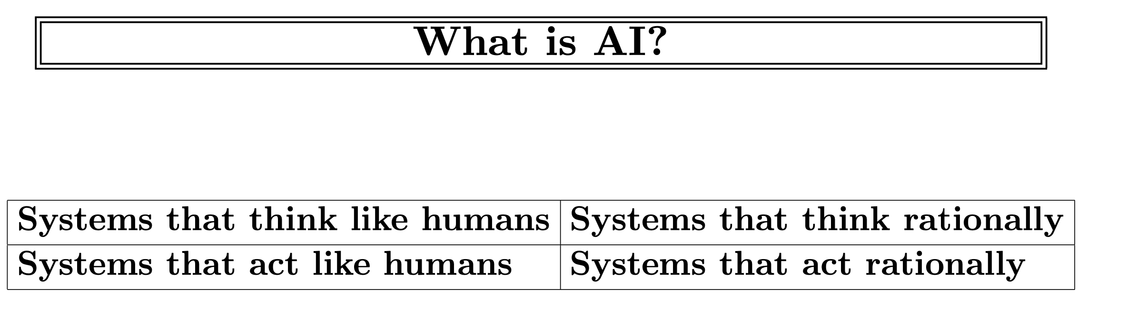
Notes:
Rationally: hợp lý

Slide 11
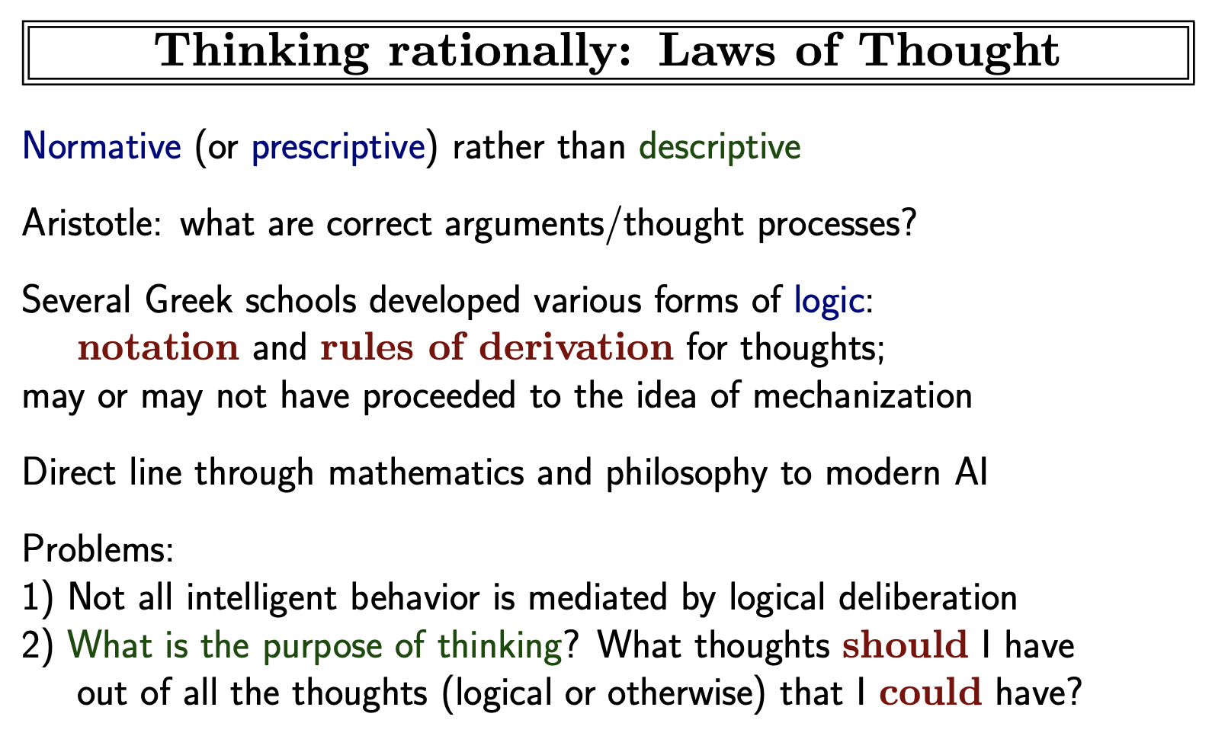
Notes:
Normative: có tính cách quy chuẩn
Prescriptive: theo quy tắc
Descriptive: mô tả
Notation: ký hiệu
Derivation: nguồn gốc
Mediate: dàn xếp
Deliberation: sự thận trọng

Slide 12
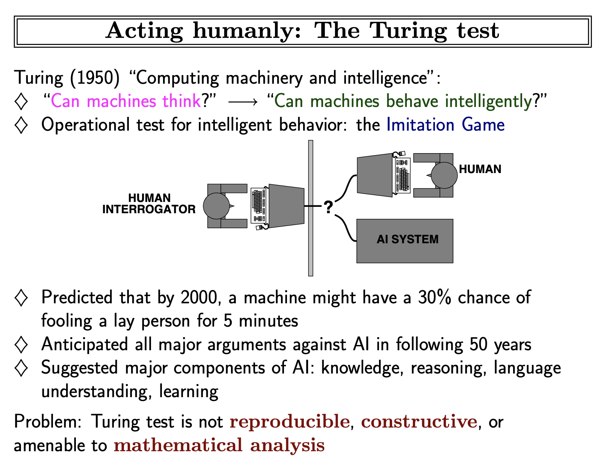
Notes:
Interrogator: người thẩm vấn
Fool: đánh lừa
Reproducible: có thể sinh sản
Constructive
Amenable to: tuân theo

Slide 13
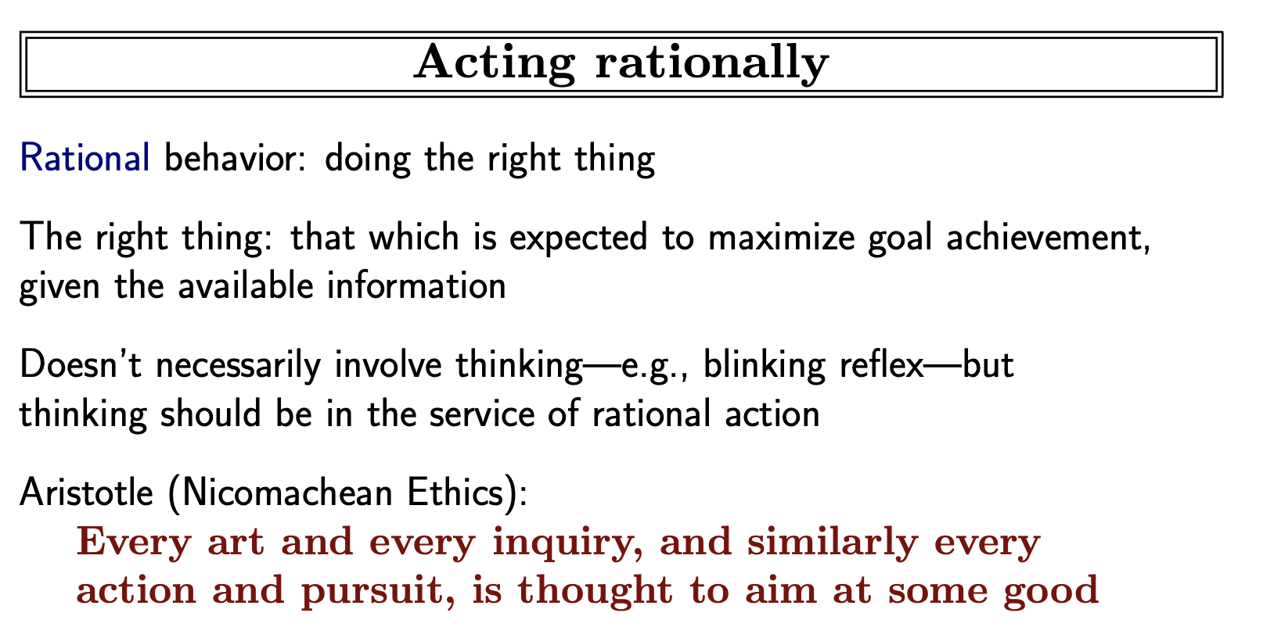

Slide 14
SOME DEFINITIONS
“Artificial intelligence is a computerised system that exhibits behaviour that is commonly thought of as requiring intelligence.” [1]
“Artificial Intelligence is the science of making machines do things that would require intelligence if done by man.” [2]
The father of AI, Alan Turing, defines this discipline as:
“AI is the science and engineering of making intelligent machines, especially intelligent computer programs.” [3]
[1] Preparing for the Future of Artificial Intelligence, NSTC, 2016 [2] Raphael, B. 1976. The thinking computer. San Francisco, CA: W.H. Freeman [3] http://www-formal.stanford.edu/jmc/whatisai/node1.html

Slide 15
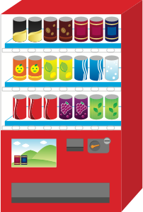

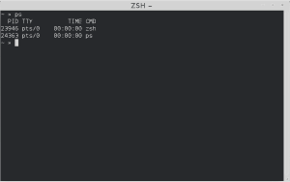


EXAMPLES

Slide 16
MAIN BRANCHES OF AI
Artificial Intelligence
Reasoning and problem solving:
Machine learning
Knowledge Representation
Robotics: motion and manipulation
Planning
Natural Language Processing
Perception: computer vision

Slide 17

MAIN BRANCHES OF AI
Reasoning and problem solving: generates conclusions from available knowledge using logical techniques. Then use that knowledge to solve problems.
Artificial Intelligence
Reasoning and problem solving:
Machine learning
Knowledge Representation
Robotics: motion and manipulation
Planning
Natural Language Processing
Perception: computer vision

Slide 18

MAIN BRANCHES OF AI
Machine learning: the techniques to give computer systems the ability to "learn".
Artificial Intelligence
Reasoning and problem solving:
Machine learning
Knowledge Representation
Robotics: motion and manipulation
Planning
Natural Language Processing
Perception: computer vision

Slide 19
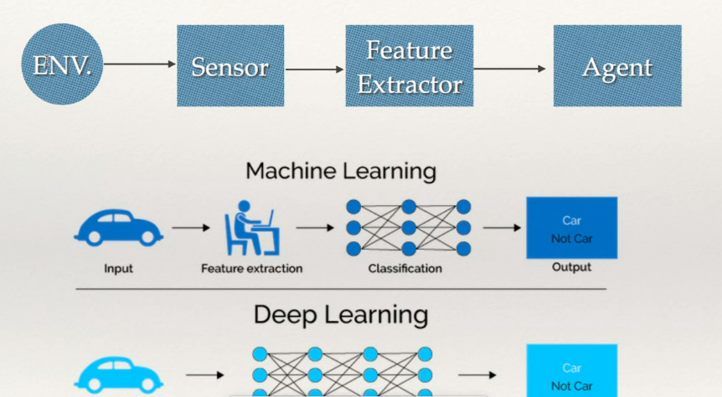
MAIN BRANCHES OF AI
Knowledge Representation: representing information about the world in a form that a computer system can utilize to solve complex tasks
Artificial Intelligence
Reasoning and problem solving:
Machine learning
Knowledge Representation
Robotics: motion and manipulation
Planning
Natural Language Processing
Perception: computer vision

Slide 20
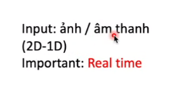
MAIN BRANCHES OF AI
Robotics: motion and manipulation. Making the robots capable of navigating different environment and manipulate
Artificial Intelligence
Reasoning and problem solving:
Machine learning
Knowledge Representation
Robotics: motion and manipulation
Planning
Natural Language Processing
Perception: computer vision
Notes:
Manipulation: thao tác
Navigate: điều hướng

Slide 21
MAIN BRANCHES OF AI
Planning: decision making tasks performed by the robots or computer programs to achieve a specific goal
Artificial Intelligence
Reasoning and problem solving:
Machine learning
Knowledge Representation
Robotics: motion and manipulation
Planning
Natural Language Processing
Perception: computer vision

Slide 22
MAIN BRANCHES OF AI
Natural Language Processing: helps computers understand, interpret and manipulate human language
Artificial Intelligence
Reasoning and problem solving:
Machine learning
Knowledge Representation
Robotics: motion and manipulation
Planning
Natural Language Processing
Perception: computer vision

Slide 23
MAIN BRANCHES OF AI
Perception: computer vision methods for acquiring, processing, analyzing, and understanding images and, in general, high-dimensional data from the real world in order to produce numerical or symbolic information
Artificial Intelligence
Reasoning and problem solving:
Machine learning
Knowledge Representation
Robotics: motion and manipulation
Planning
Natural Language Processing
Perception: computer vision

Slide 24
SOME EXAMPLES
Artificial Intelligence
Reasoning and problem solving:
Machine learning
Knowledge Representation
Robotics: motion and manipulation
Planning
Natural Language Processing
Perception: computer vision
AI game agents, web crawlers
Recommendation systems
Chatbots, virtual assistants
Humanoid robots
Rocket path planning
Siri
Filters in snap chap, Animoji in iPhone

Slide 25
